Slide 1
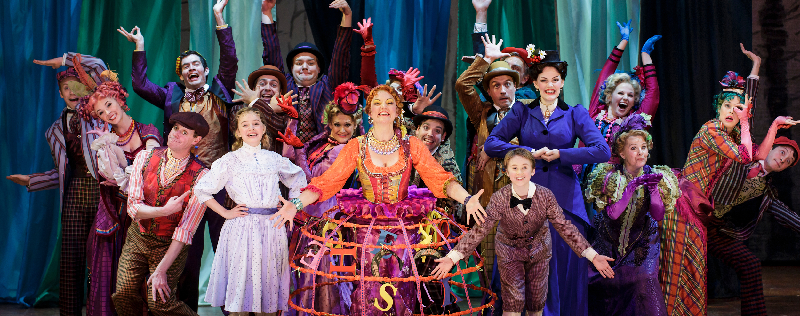
Danville Community Theater Group
Zachary Eaves , Nimit Kaneria, Leilla Memisevic

Slide 2

About Danville Theater
Produces multiple plays each year
Non for Profit Organization
Has 200 Members
Yearly membership Costs $50
Business Goals
To maintain a efficient database that tracks of members and productions.
To start a subscription based seating arrangements in the theater.
What they want?
Create a database which tracks productions and members
database to compile name and addresses of potential customers and past sponsors which will help them announce efficiently with patrons.

Slide 3
Introduction
Problems Faced by Danville Theater
Before DBMS
Struggled tracking productions and members
Hard to allot seating to potential members.
Struggled to keep contacts and information about current and past investors
After DBMS
Easy to maintain,add and manage data
keeps track of customers and productions
can easily allot seats to the subscribed members
Find the data and information of the members quickly

Slide 4
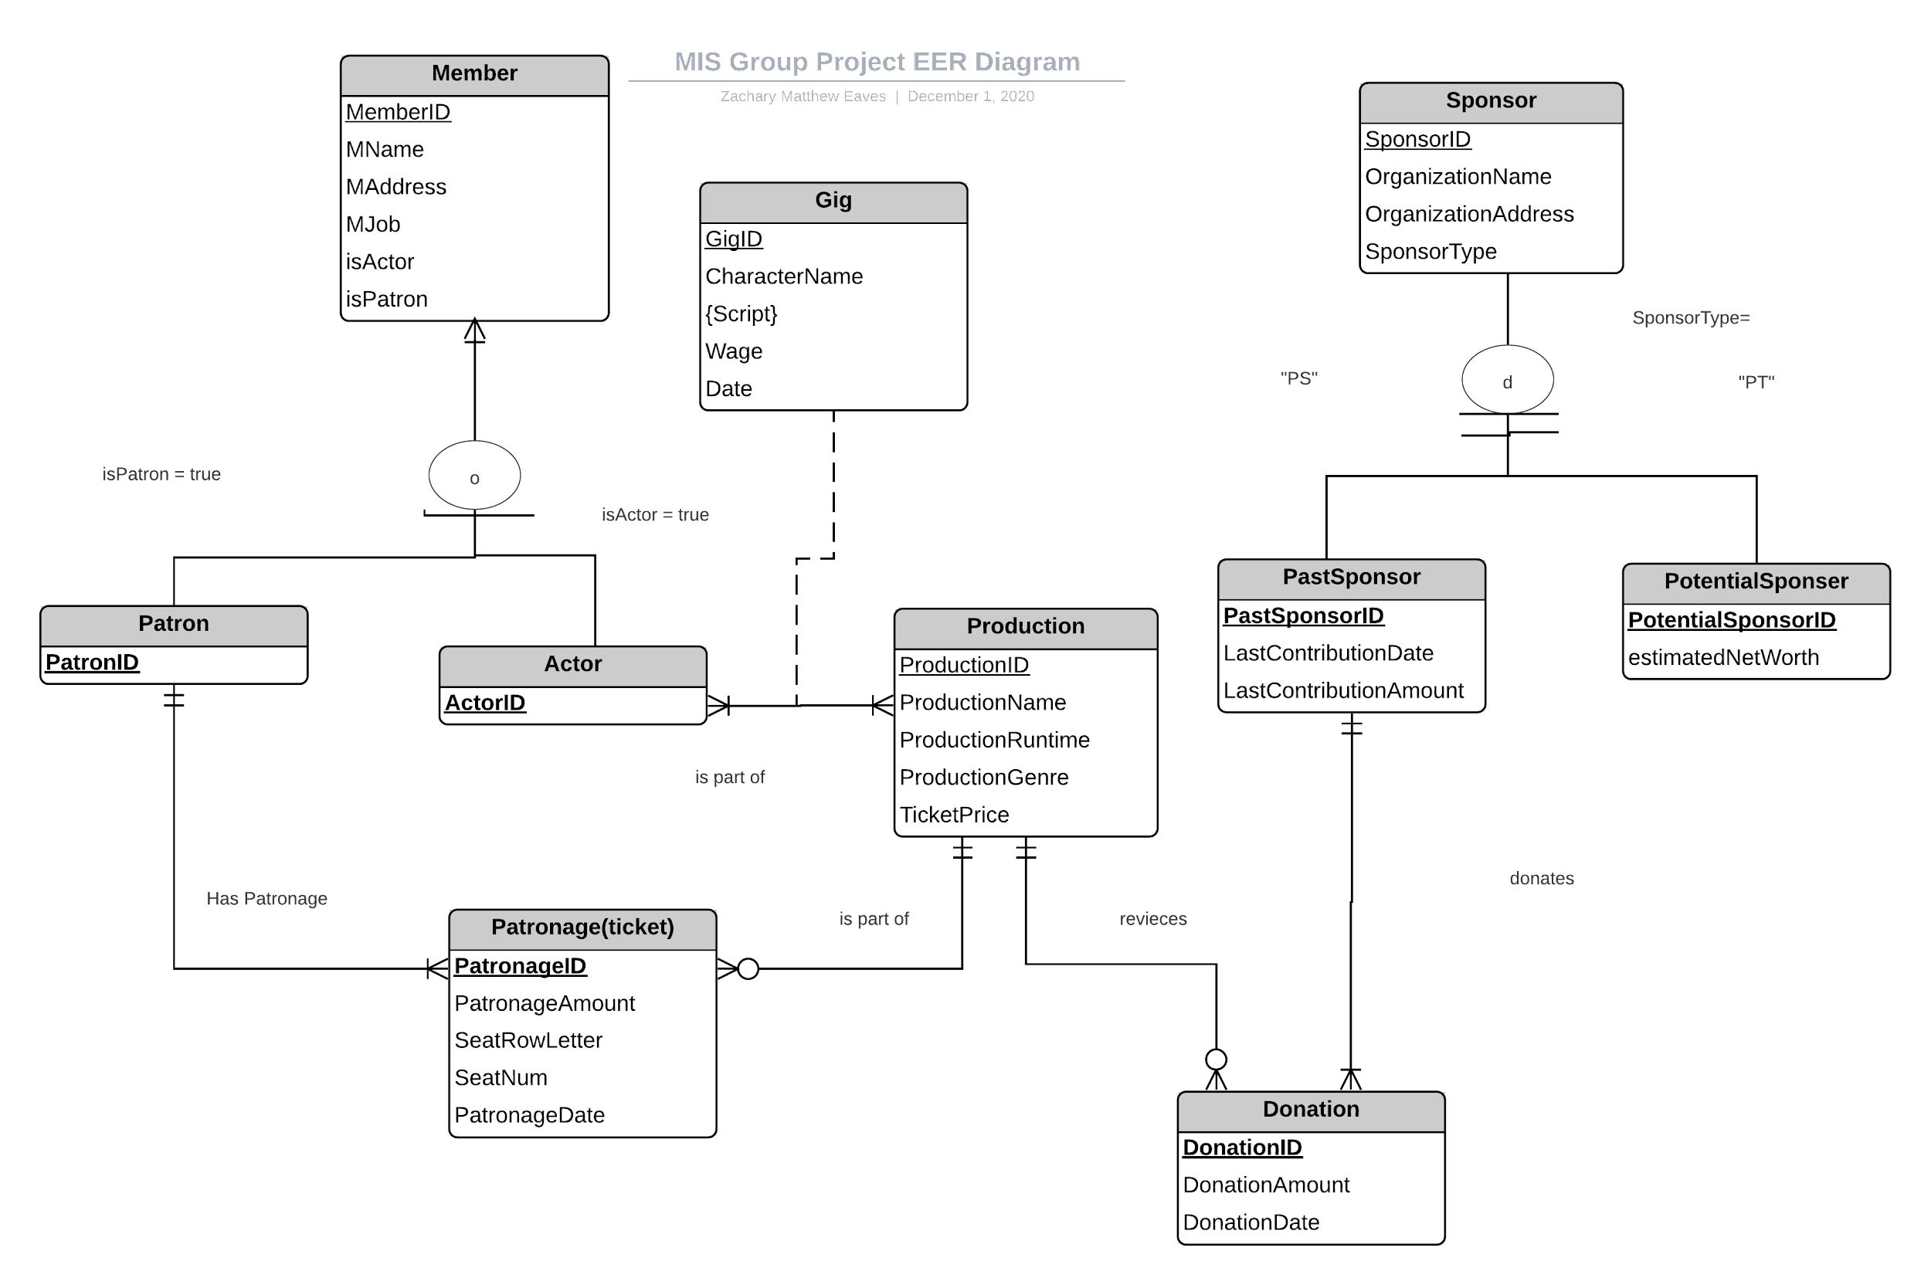
Conceptual Diagram

Slide 5
Assumptions
A member can be both a patron and an actor.
Each subscription or donation is for exactly one production.
A production can receive any amount of donations or subscriptions including zero.
A patron can have one or multiple patronages.
A patronage is associated with one and only one patron.
Each sponsor must be stored as either a past sponsor with a lastContributionDate and lastContributionAmount , or a potential sponsor with an estimated Net Worth.

Slide 6
Assumptions
Each donation is associated with one and only one past sponsor.
Each past sponsor can be associated with one or many donations.
Script Text lists the full script of the character, with the points in the production for each text included in the hypertext.
A donation is for one and only one production.
A production can receive zero or many donations
New entity gig is a result of the many to many relationships between actor and production
Since actors can be both an actor and a patron, we need to set the database up to allow for individual people to donate without receiving a seat

Slide 7
Relational Tables
Member: MID, MName, MAddress, MJob, IsActor, IsPatron
Actor: ActorID [ActorID is foreign key to Member]
Patron: PatronID [PatronID is foreign key to Member]
Production: ProductionID, ProductionName, ProductionRuntime, ProductionGenre, TicketPrice

Slide 8
Relational Tables
Patronage: PatronageID, PatronageAmount, SeatRowLetter, SeatNum, PatronageDate, ProductionID, PatronID [ProductionID is foreign key to Production, PatronID is foreign key to Patron]
Gig: GigID, CharacterName, ScriptID, Wage, Date, ActorID, ProductionID [ActorID is foreign key to Actor, ProductionID is foreign key to Production, ScriptID is foreign key to Script]
Script: ScriptID, GigID, ScriptText [GigID is foreign key to Gig]
Sponsor: SponsorID, OrganizationName, OrganizationAddress, SponsorType

Slide 9
Relational Tables
PastSponsor: PastSponsorID [PastSponsorID is foreign key to Sponsor]
PotentialSponsor: PotentialSponsorID [PotentialSponsorID is foreign key to Sponsor]
Donation: DonationID, DonationAmount, DonationDate, PastSponsorID, ProductionID [ProductionID is foreign key to production, PastSponsorID is foreign key to PastSponsor]

Slide 10
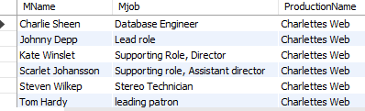
SQL QUERY: CAST AND CREDITS
List names of members along with the role each played and the jobs each had for production
Select Member_.MName, Member_.Mjob, Production.ProductionName
From Member_, Production
Where MJob is not NUll
and Production.ProductionID = 300000;
(change this to a specific prod^^^)
Members will not be selected if their job
is null

Slide 11
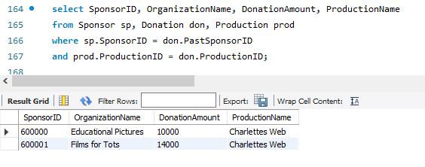
SQL QUERY: SPONSORS
List all corporations and individuals who donated money, goods, or services for each production

Slide 12
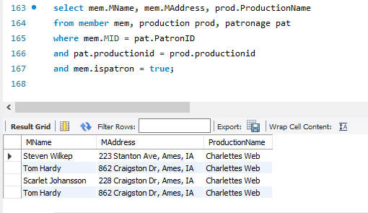
SQL QUERY: REPORT OF PATRONS
List mailing information for patrons, as well as list of productions they bought tickets for in the past(this will also list them if they have made a patronage without recieving a ticket)

Slide 13
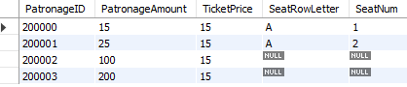
SQL QUERY: TICKET SALES REPORT
List tickets, along with price and seat numbers, that patrons have ordered for productions
Select Patronage.PatronageID, Patronage.PatronageAmount, Production.TicketPrice, Patronage.SeatRowLetter, Patronage.SeatNum
From Patronage, Production
Where Patronage.ProductionID = Production.ProductionID;
If someone were to give a patronage below the ticket price(which they can do) then they will not be given a seat or row num. Similarly if someone were to just donate by themselves and not through a corporation, we can record their cashflow in the same column, again, without a seat.

Slide 14
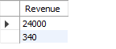
SQL QUERY(CUSTOM QUERY #1): Total Production Revenue:
List the total(sums) revenues received by both donations and Patronages for a specific production
Select Sum(Donation.DonationAmount) as Revenue
from Donation
Where Donation.ProductionID = 300000
Union
Select Sum(Patronage.PatronageAmount) as Revenue
From Patronage
Where Patronage.ProductionID = 300000;

Slide 15
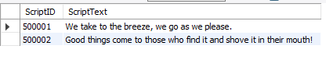
SQL QUERY(CUSTOM QUERY #2)Character Script
Lists all of the script for a given character, With the ScriptID also Keeping track of when each person has to speak(this is assuming the script of the production will be given in chronological order when entered into the database:
Select Script.ScriptID, Script.ScriptText
From Script
Where Script.GigID = 400000;
^^(change this to a specific character)

